Slide 1

Active Directory: The good, The bad, and the lolWUT?
Defcon 31 Workshop

Slide 2

Aaron Rosenmund @arosenmund

Slide 3
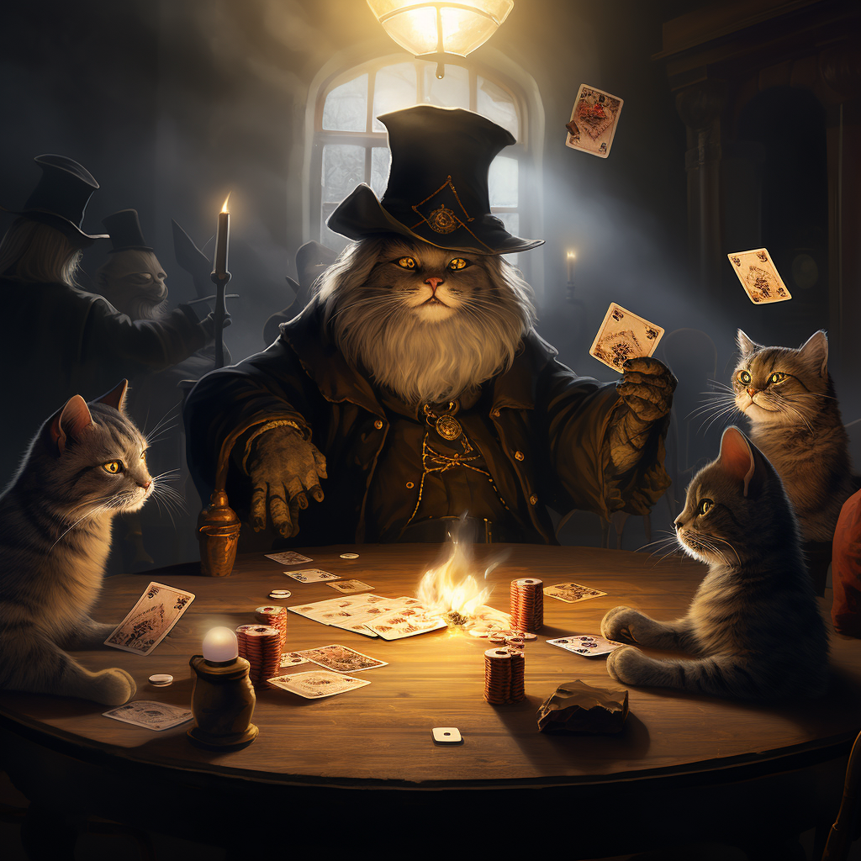
Brandon DeVault @solderswag

Slide 4

Ryan Chapman @rj_chap

Slide 5
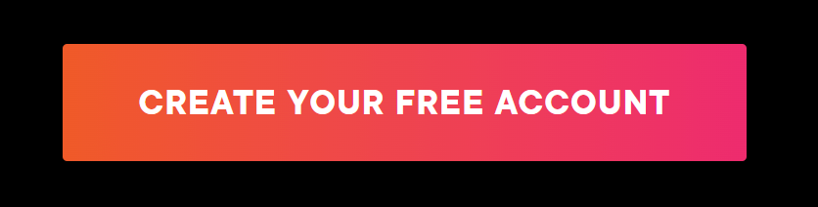
The Lab Environment Account Required: www.pluralsight.com/free (no cc required)

Slide 6
Active Directory Sandbox

Slide 7
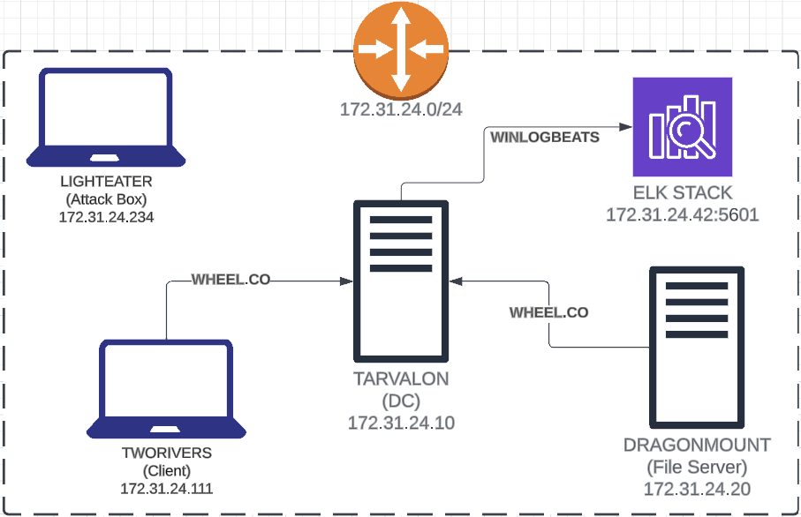

Slide 8
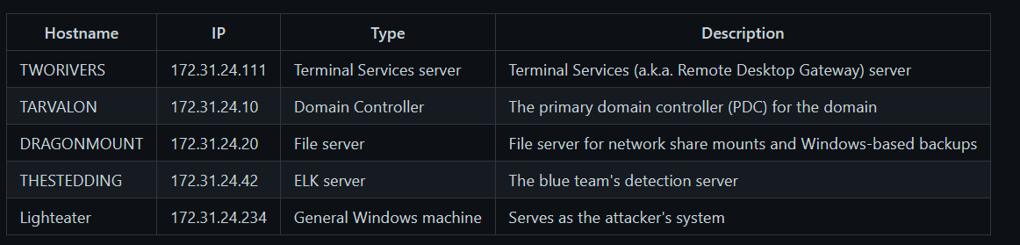

Slide 9
Credential Grabbing

Slide 10
Enumeration

Slide 11
Kerberoasting

